Slide 1

Introduction to Computer Systems
Pipelining
Direct Link to view these slides on Google Docs

Slide 2
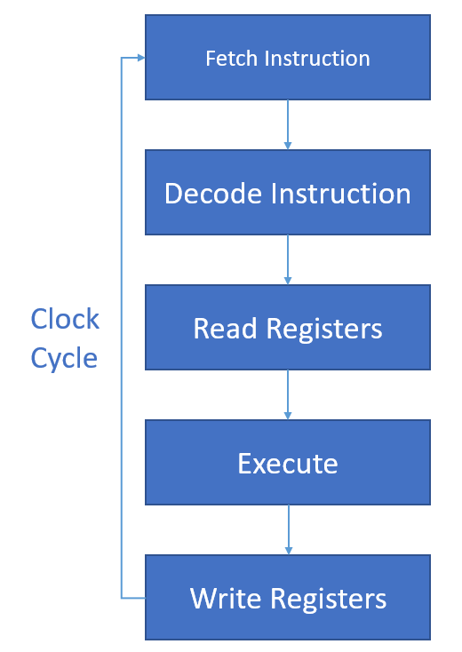
Fetch Execute Cycle
Conventional Processor (assuming load store architecture):
Much of the circuitry is idle for most of the clock cycle.
Latency - time to execute one instruction
Throughput - how many instructions per second
Throughput = 1/latency

Slide 3
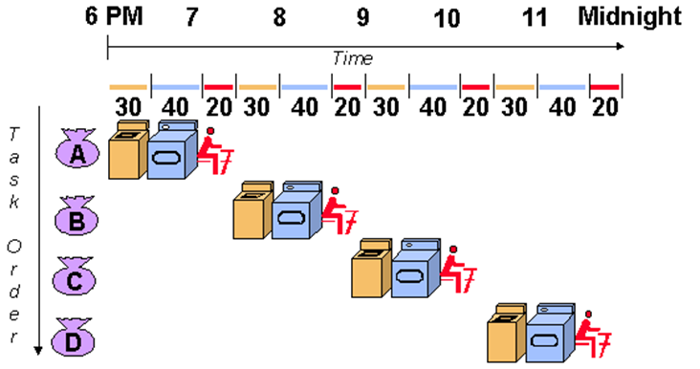
Laundry Problem
Sequential laundry takes 6 hours for 4 loads

Slide 4
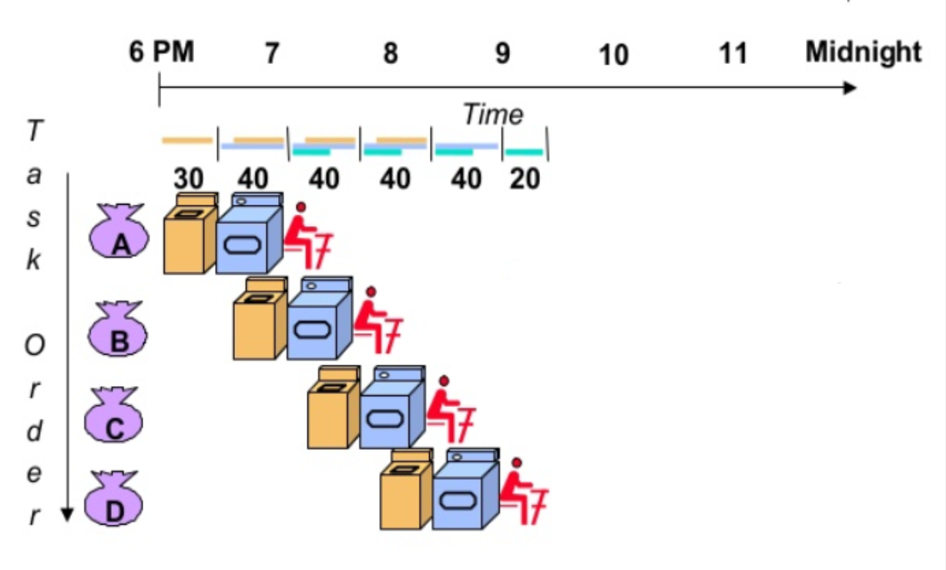
Laundry Problem
Sequential Laundry takes 6 hours for 4 loads
Pipelined laundry takes 3.5 hours for 4 loads

Slide 5
Pipelining
With pipelined processors:
Throughput: Number of instructions per second
Latency: Time for one instruction
Pipelining overlaps execution of one instruction with fetching on the next instruction
With pipelining throughput > 1/latency

Slide 6
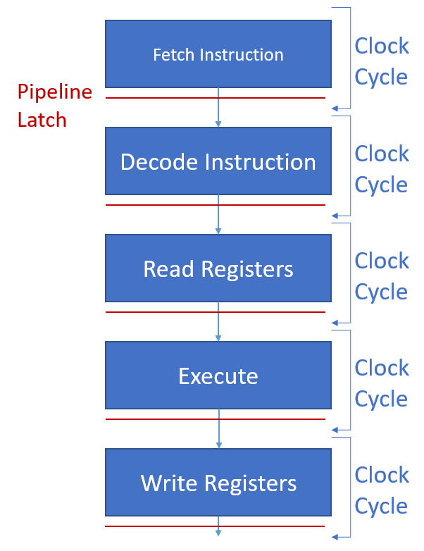
Conventional Processors vs Pipelined Processors
Conventional Processor
Pipelined Processor

Slide 7
Pipelining
Data path is divided into stages
Stages all operate simultaneously
Modern processors have in the order of five or more (~8) stages
Pipeline latches prevent data entering the next stage before previous data has left
Latch occupies space on silicon chip
Less space for processing elements
May imply some storage of results
Each stage has latency of one cycle time
Cycle time should be much shorter than in conventional processor
Pipeline latches: (these instructions were stored in a special set of registers called prefetch buffer/latches)

Slide 8
Fetch and Execute Cycle without Pipelining
T | Fetch | Decode | Read | Execute | Write
1 | Inst 1
2 |  | Inst 1
3 |  |  | Inst 1
4 |  |  |  | Inst 1
5 |  |  |  |  | Inst 1
6 | Inst 2
7 |  | Inst 2
8 |  |  | Inst 2
9 |  |  |  | Inst 2
10 |  |  |  |  | Inst 2
* 10 cycles (T) in total.

Slide 9
Pipelining
T | Fetch | Decode | Read | Execute | Write
1 | Inst 1
2 | Inst 2 | Inst 1
3 | Inst 3 | Inst 2 | Inst 1
4 | Inst 4 | Inst 3 | Inst 2 | Inst 1
5 | Inst 5 | Inst 4 | Inst 3 | Inst 2 | Inst 1
6 | Inst 6 | Inst 5 | Inst 4 | Inst 3 | Inst 2
7 | Inst 7 | Inst 6 | Inst 5 | Inst 4 | Inst 3
*Notice how instructions complete one every cycle (T), only 7 cycles in total, where in the conventional were 10 cycles
*Latency is 5 cycles

Slide 10
Cycle Time of Pipelined Processors
Cycle Time pipelined = (Cycle Time unpipelined ÷ Number of Pipeline Stages ) + Pipeline Latch Latency
each stage contains less logic, hence the time for a stage is less than the original cycle time
More stages (e.g. 8 stages) also means a higher total pipeline latch latency
Pipeline stages ideally have to be the same length
If they haven’t (uneven pipeline stages) then cycle time must be long enough to accommodate the longest stage of the pipeline
More data in the pipeline latch makes it larger (time) on chip
MIPS originally designed so pipeline stages identical in length so no latches were needed
Pipelined Processor

Slide 11
Pipeline Latency
Pipelining can reduce the processor’s cycle time (simpler stages)
Pipelining increases the latency of the processor by at least the sum of all the pipeline latch latencies
Latency of a pipeline = # pipeline stages x clock cycle time

Slide 12
Instruction Hazards and their Impact on Throughput
Pipeline’s peak rate is limited by the time required to access memory and
dependencies between instructions (Data / instruction hazard)
branch instructions (Control hazard)
Resource conflicts (Structural hazard)
Data/instruction hazards (dependencies) occur when instructions read or write registers that are used by other instructions
conditional branch instructions cause problems because next instruction is uncertain until branch executes

Slide 13
Instruction Hazards and their Impact on Throughput
Read after Read hazard (RAR)
Not a problem – register value doesn’t change
add $s1,$s3,$s5
sub $s2,$s8,$s3
Read after Write hazard (RAW)
Needs to be detected and instruction delayed (stall) until result available
add $s3,$s5,$s7
sub $s2,$s8,$s3
Pipeline stall or bubble needs to be inserted in pipeline
Reading instruction can go through instruction fetch and instruction decode stages

Slide 14
Instruction Hazards and their Impact on Throughput
Write after Write hazard (WAW)
add $s9,$s2,$s5
sub $s9,$s6,$s7
Write after Read hazard (WAR)
add $s1,$s2,$s5
sub $s5,$s6,$s7
WAR, WAW: output register of an instruction has been either read or written by a previous instruction; caused by limited number of registers (if the same pipeline is used for all instructions, this is not a problem)
Problem if a low-latency instruction completes before a long-latency instruction from earlier in the program

Slide 15
Pipeline Stalls of Bubbles
T | Fetch | Decode | Read | Execute | Write
1 | add $s1,$s2,$s3
2 | sub $s6,$s7,$s1 | add $s1,$s2,$s3
3 |  | sub $s6,$s7,$s1 | add $s1,$s2,$s3
4 |  |  | sub $s6,$s7,$s1 | add $s1,$s2,$s3
5 |  |  | sub $s6,$s7,$s1 | bubble | add $s1,$s2,$s3
6 |  |  | sub $s6,$s7,$s1 | bubble | bubble
7 |  |  |  | sub $s6,$s7,$s1 | bubble
 |  |  |  |  | sub $s6,$s7,$s1
Sub instruction cannot read register R1 until the cycle after the add instruction has written it
Good high level language compilers rearrange code order to minimise stalls

Slide 16
Conditional Branches
Conditional branches create data dependencies since branch instruction computes the address of the next instruction that needs to be fetched
Branch delays (control hazards) occur between a branch instruction entering the pipeline, and the next instruction entering
Branch prediction: add hardware that predicts the destination address of each branch, and begin fetching those instructions
Speculative execution: have extra hardware and execute both possible code paths, committing correct results to registers when branch is executed

Slide 17
Branching
T | Fetch | Decode | Read | Execute | Write
1 | bne $s6,$s7,go
2 ** | Next instruction A | bne $s6,$s7,go
3 | bubble | bubble | bne $s6,$s7,$,go
4 | bubble | bubble | bubble | bne $s6,$s7,go
5 | bubble | bubble | bubble | bubble | bne $s6,$s7,go
6 ** | Next instruction X | bubble | bubble | bubble | bubble
7 |  |  | bubble | bubble | bubble
**Stage 2: Following instruction will be fetched
**Stage 6: Actual next instruction will be fetched after writing of PC by branch

Slide 18
Scoreboarding
Scoreboarding is mechanism for inserting bubbles
add $s1,$s1,$s4
sub $s5,$s1,$s2
Presence bit records whether the register is available for reading (full), or waiting for an instruction to write its output value (empty).
Hardware reads all full input registers, marks output register as empty, and allow instruction to proceed to the execute stage on the next cycle
If not, instruction is held until its input registers become full, inserting bubbles
When instruction writes back, that register is marked full, allowing operations that read the register to proceed
Register | Presence Bit
$s0 | 1 ~full
$s1 | 0 ~empty
$s2 | 1 ~full

Slide 19
Result Forwarding (Bypassing)
Bypassing: forwarding results to other instructions before writing them into registers
does not improve branch latency, because results of branches are not written into registers
Some processors use registers that are written in the first half of a clock cycle, and read in the second half

Slide 20
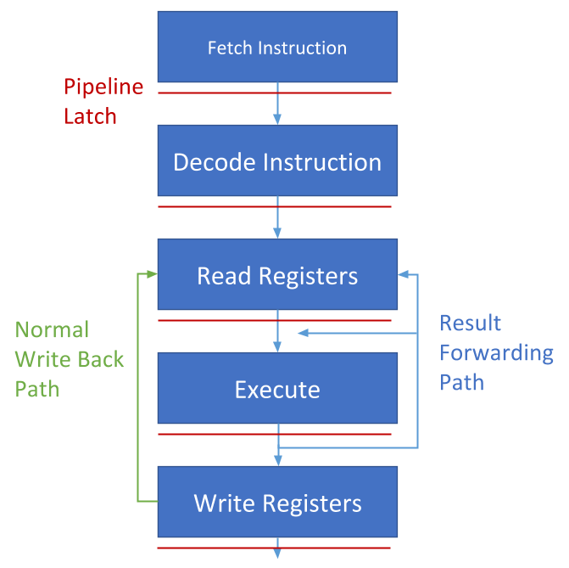
Bypassing Data Paths

Slide 21
Improving Branch Performance
Conditional branches cause pipeline stalls
How can we improve branch performance?
Predict result of branch
Execute both possible sets of operations
Branch prediction
Predict (guess?) which branch will be taken
Execute that branch, but don’t write to registers until branch result known
Speculative execution
Execute both possible paths through code
When branch result known commit results to registers
Needs extra shadow registers

Slide 22
Summary
Pipelining increase throughput by starting to process one instruction before earlier ones have finished
Ideally different stages in pipeline take similar amount of time
Pipeline stalls occur because of dependencies between instructions
Discarding instructions in the pipeline is referred to as Flushing (stall) >> more
Conditional branch instructions also cause stalls

